Slide 1


EE463: STATIC POWER CONVERSION I DC MOTOR DRIVE PROJECT FEEDBACK SESSION
Muhammet Kamer Taha GENÇ 2234748
Mustafa Burak ÇORUK 2442812
Öykü KAYAN 2516391

Slide 2
OUTLINE
Project Requirements
Topology Selection
Simulations
PWM Generator
Component Selection
Bonus Parts

Slide 3
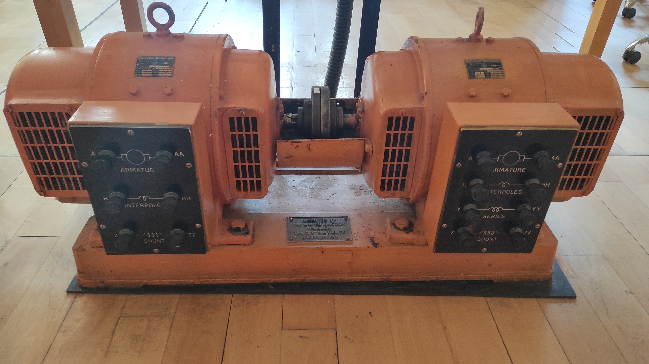
PROJECT REQUIREMENTS
Power Input: 3 Phase, or 1 Phase AC Grid (Adjustable with variac)
Output: Adjustable DC Output (Vout,max = 180 V)
Armature Winding: 0.8 Ω, 12.5 mH
Shunt WINDING: 210 Ω, 23 H
Interpoles Winding: 0.27 Ω, 12 mH

Slide 4
TOPOLOGY SELECTION
Single Phase Diode Rectifier
Advantages: Simple, cost-effective, suitable for low-power applications.
Disadvantages: High output ripple, limited efficiency at higher power levels.
Three Phase Diode Rectifier
Advantages: Higher output voltage, smoother DC output, efficient for high-power applications.
Disadvantages: More complex and costly than single-phase systems.
Single Phase Thyristor Rectifier
Advantages: Adjustable output voltage, low conduction losses, simple design.
Disadvantages: Requires control circuit, higher ripple.
Three Phase Thyristor Rectifier
Advantages: Higher and smoother output voltage, consistent power delivery.
Disadvantages: Complex control system, harmonic distortions, higher cost.

Slide 5
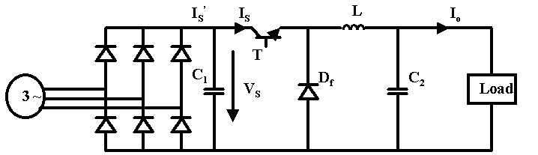
SELECTED TOPOLOGY
Three-Phase Diode Rectifier with Buck Converter
Combines high output voltage, smooth DC supply, and simplified control for efficient high-power motor applications.

